Slide 1

Trends in New England Energy Efficiency Policy New England Restructuring Roundtable
Sue Coakley, Executive Director
Northeast Energy Efficiency Partnerships (NEEP)
February 15, 2013

Slide 2
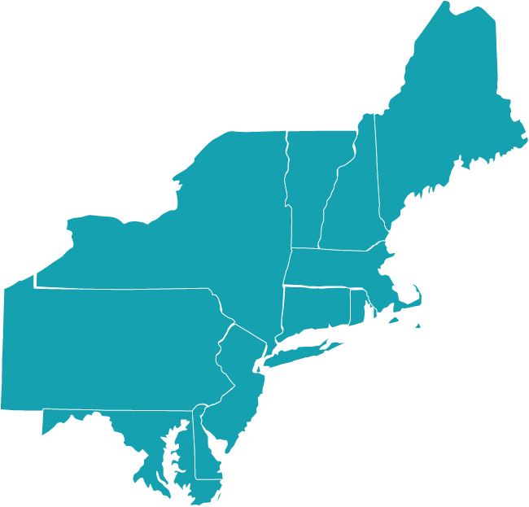
ABOUT NEEP
MISSION
Accelerate energy efficiency in homes, buildings and industry in the Northeast – Mid-Atlantic region.
VISION
The region wholly embraces energy efficiency policies and solutions as a cornerstone of a sustainable energy policy, a vibrant economy, and a healthy environment for people to live and work in.
APPROACH
NEEP brings key stakeholders together with expertise and leveraged resources to innovate and apply best practices across the region.
Serving the Northeast & Mid-Atlantic states since 1996

Slide 3
ABOUT NEEP
NEEP’S REGIONAL VALUE PROPOSITION
Identify/Promote Innovation & Best Practices
Reduce Costs/Share Risk
Accelerate Market Momentum
Increase Energy Savings
Common Requirements
Consistent Messages
Aggregated Markets
Consistent Measurement & Reporting
Leveraged Resources
Result - Energy Savings:
More!
Deeper!
Faster!
Cheaper!

Slide 4
The Smart Bet: Energy Efficiency Could Offset Load Growth
NEEP 2004-5 Regional Energy Efficiency Potential Study:
EE Potential vs. 2004 CELT Forecast
150,000
Existing EE
ISO GWh Forecast (w/out DSM)
Programs at
145,000
1.2% Avg. Annual Increase at
3.1¢/kWh
Marginal Avoided Energy Supply Cost of 9.4
¢
/kWh
Building
140,000
Codes at
2.9¢/kWh
135,000
Addt'l EE Can Offset Growth
Standards at
(at 3.1¢/kWh)
1.0 ¢/kWh
130,000
Addt'l
GWh
125,000
Actual Energy Requirement (2003)
Savings
Opport.
120,000
Beyond
Offsetting
Growth (at
115,000
3.1¢/kWh)
Total Achievable Energy Savings Potential
Total EE
110,000
-1.38% Avg. Annual Reduction
Potential in
2013 Can
105,000
Reduce
Energy Req.
100,000
to 1993 Level
2004
2005
2006
2007
2008
2009
2010
2011
2012
2013

Slide 5
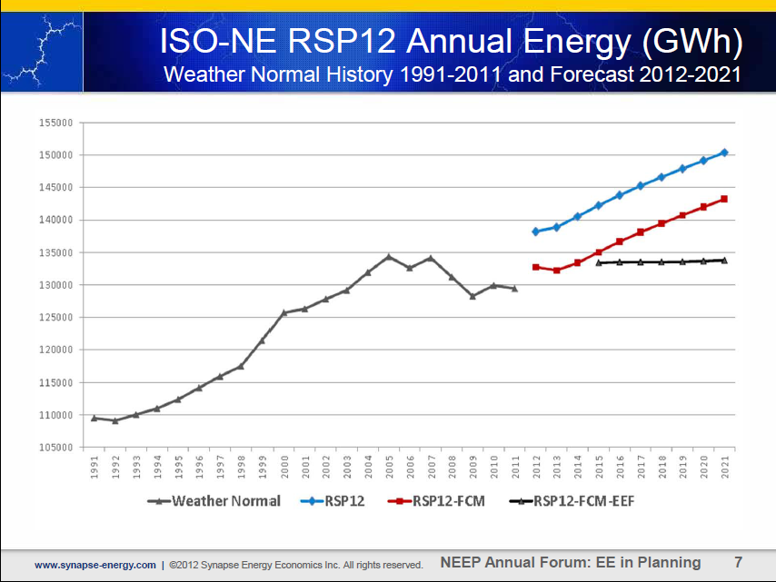
The Trend: No Growth in Electricity
Consumption through 2021
Paul Peterson, Synapse Energy Economics, EM&V Forum Annual Public Meeting, December 2012, http://neep.org/uploads/EMV%20Forum/Calendars/Synapse%20EE%20in%20System%20Forecasting.pdf

Slide 6
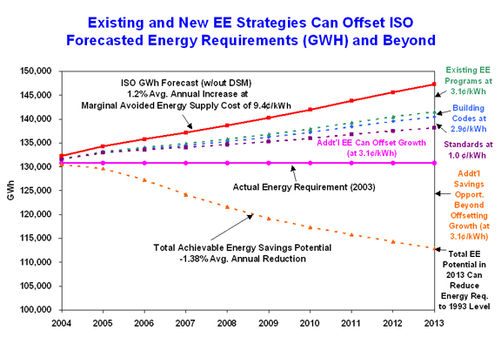
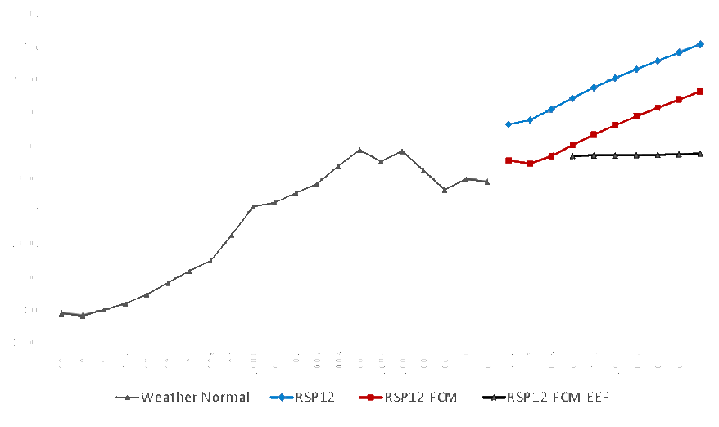
Bottom Line:
We can Offset Load growth

Slide 7
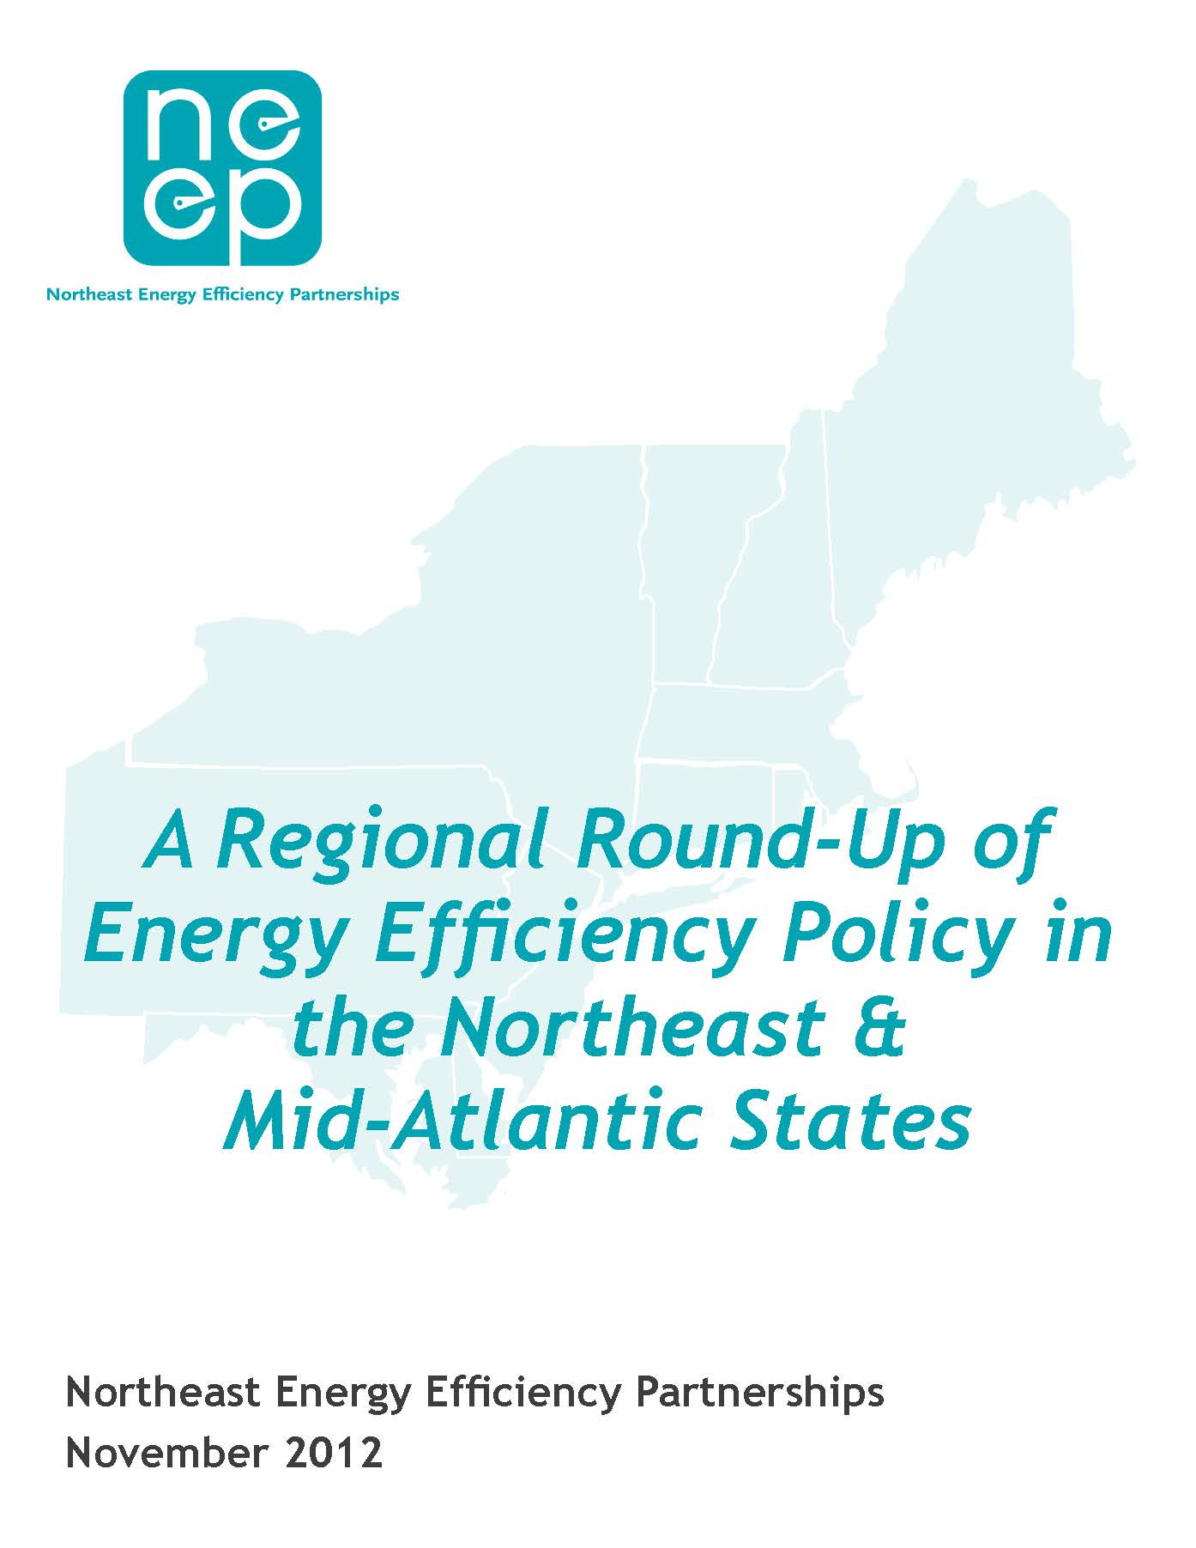
Northeast States Embrace Efficiency as Cornerstone of Energy Policy
1. A DEFINED POLICY DIRECTIVE
Nine states with legislative directives to:
    Capture “all cost-effective energy efficiency: (MA, CT, ME, RI, VT)
    Meet defined energy efficiency savings targets, i.e. EE Portfolio Standard (MD, PA, NY, DE)
2. SUFFICIENT AND STABLE FUNDING
Most states ramping up funding though some still capped (NH, ME, PA, DE, NJ, DC)
Many states have decoupling and/or performance incentives (MA, CT, RI, VT, NH, NY)
3. STAKEHOLDER ADVISORY FRAMEWORK
Advisory councils in MA, CT, RI, ME
  - Broad representation with expert consultants
  - Work out issues before getting to regulators

Slide 8
Active Support for Complementary
Energy Efficiency Policies
APPLIANCE STANDARDS
  New Northeast state model package 2013, expanding in 2014
  Active engagement in federal rulemakings
BUILDING ENERGY CODES
  Need strong support for energy code compliance
  Obstacles to adoption of 2012 model energy codes (ME, PA, MA, CT)
BUILDING ENERGY RATING & DISCLOSURE
  Pilots for new residential rating tools (MA and CT), and commercial (MA, in concert with NEEP)
  New rating bill just filed in VT
  Commercial benchmarking ordinances in D.C., Philadelphia, NYC, Boston (any day now…)
POLICY INTEGRATION WITH EE PROGRAMS
  New 2013 codes/standards support program in RI, pilot in MA
  NEEP EM&V Forum report on guidelines for claimed savings

Slide 9
STATE SPENDING ON ENERGY EFFICIENCY
2013 Per Capita Program Spending
Efficiency investments rising in many New England and Mid-Atlantic states..
2012 continues trend ➔ more robust investments in energy efficiency,
Three states spending over $50 per capita last year.

Slide 10
Electric ENERGY Savings 2010-2012
As percent of state retail electric sales
Policy is driving efficiency to make up a growing portion of our electricity resource
Leading states achieving savings of 1.5 to 2 percent of their annual electric sales.

Slide 11
CHALLENGES AHEAD
Savings goals are rising while baselines are also rising because of building energy codes & standards
Benefit-cost ratios may fall, but still remain significantly above 1.0
Must grapple with problems with cost-effectiveness screenings
Accountability: Need for better regional data: Regional Energy Efficiency Database (preview)

Slide 12
REGIONAL EE DATABASE (REED) PREVIEW
  REED - A product of the Regional Evaluation, Measurement and Verification Forum that builds on the Common Statewide EE Reporting Guidelines, adopted by EM&V Forum Steering Committee in December 2010.
Purpose:
Develop transparency and consistency in reporting of EE impacts across the region
Increase the credibility and understanding of the EE resource
Support state and regional energy, economic and environmental policies.
Launch - February 20: at www.neep-reed.org.
11

Slide 13
REED OUTPUTS/REPORTS – 2011 DATA
Reporting Titles with descriptions of filter options (all by state or sub-region)
Cost of Saved Energy ( lifetime and levelized cost/kWh or cost/therm)
Total Peak Demand Savings (by total, sector or program type, and either net or gross)
Total Annual Electric Savings (by total, sector or program type, and either net or gross)
Total Lifetime Electric Savings (by total, sector or program type, and either net or gross)
Total Annual Gas Savings (by total, sector or program type, and either net or gross)
Total Lifetime Gas Savings (by total, sector or program type, and either net or gross)
Total Annual Expenditures and as % of Total Costs (by total, and electric and/or gas)
Savings as a % of Utility kWh Sales (user to select electric and/or gas)
Total Avoided Emissions (NOx, SO2, CO2)
Total Jobs Created (Direct and Indirect) - from electric and/or gas programs
12

Slide 14
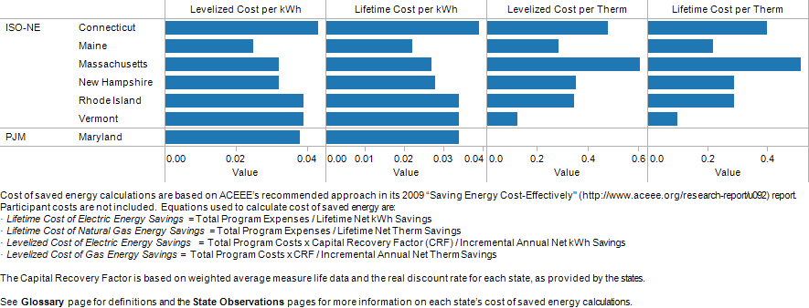
DRAFT DATA NOT FOR PUBLIC USE
COST OF SAVED ENERGY
FOR ELECTRIC & GAS (2011)
13

Slide 15
RESOURCES FROM NEEP
We have an abundance of news and policy resources on our website, www.neep.org. These include:
Highlights, a bi-monthly policy news and analysis e-newsletter
Energy Efficiency Matters, our blog
The Efficiency Policy Snapshot – the states “by the numbers”
The Regional Roundup, Annual comparison of states’ progress on EE policies
The Regional Evaluation, Measurement and Verification Forum, which supports the development and use of common protocols to evaluate, measure, verify, and report the impacts of energy efficiency.
Plus information on building science and technologies, efficiency programs, regional best-practices, regulatory guidance and more.

Slide 16

Thank you!
Sue Coakley, scoakley@neep.org
Northeast Energy Efficiency Partnerships
91 Hartwell Ave Lexington, MA 02421
P: 781.860.9177 www.neep.org

